Slide 1
Microsoft Teams Developer
Bots, Messaging Extensions and Cards

Slide 2

Bots in Microsoft Teams
Conversations
Notification-Only Bots
Sending and Receiving Files (Preview)
DEMO

Slide 3
Conversations
Series of messages sent between your bot and one or more users. Conversations are in one of the following scopes:
Teams
Also called channel conversations, visible to all members of the channel.
Personal
Conversations between bots and a single user.
Group chat
Chat between a bot and two or more users.
(In developer preview – Sep 2018)

Slide 4
Bot Events in Microsoft Teams
Activity objects are used to pass information back and forth between bot and channel (or user). Activities can represent Events, denoted by ActivityType == ‘conversationUpdate’
Team Member Events
teamMemberAdded
teamMemberRemoved
Payload object contains added/removed members
*Adding bot fires this event
Channel Events
channelCreated
channelRenamed
channelDeleted
ChannelData object reflects current state
Team Events
teamRenamed
ChannelData object reflects current state
Reactions
reactionsAdded
reactionsRemoved
replyToId contains the ID of the specific message
Notes:
Teams will send notifications to your bot for changes or events that happen in contexts where your bot is active. You can use these events to trigger service logic, such as:
Trigger welcome message when your bot is added to a team.
Query and cache team information when the bot is added to a team.
Updated cached information on team membership or channel information changes.
Remove cached information for a team if the bot is removed.
Since bot is scoped to team, no events for team creation/deletion provided.
When bot is added/removed, TeamMember events are sent.

Slide 5
Teams Context
Your bot can access additional context about the team or chat, such as user profile. This information can be used to enrich your bot's functionality and provide a more personalized experience.
Members in conversation
var mbrs = await connector.Conversations .GetConversationMembersAsync(
message.Conversation.Id );
foreach (var mbr in mbrs.AsTeamsChannelAccounts())
{
[...]
}
Channels in Team
ConversationList channels = client .GetTeamsConnectorClient() .Teams .FetchChannelList( activity.GetChannelData<TeamsChannelData>() .Team.Id );
Notes:
Use the Microsoft.Bot.Connector.Teams package to get extension methods for Microsoft Teams. Handles the parsing of the Bot Framework payload with Teams-specific functionality.

Slide 6
Proactive Messaging
A proactive message is an activity sent by a bot to start a conversation
Start Personal conversation
Must have user’s information cached
From team roster
From previous interaction with user
From conversationUpdate events
Use the CreateOrGetDirectConversation method
Start Channel conversation
Must have channel information cached
From previous interaction in channel
From conversationUpdate events
To create conversation:
Create ConnectorClient with service Uri
Call connector.Conversations.CreateConversationAsync, passing channel account for bot
Set Conversation property of new message
Call connector.Conversations.SendToConversationAsync
Notes:
Personal conversation requires User Id (from Teams) and Tenant Id

Slide 7
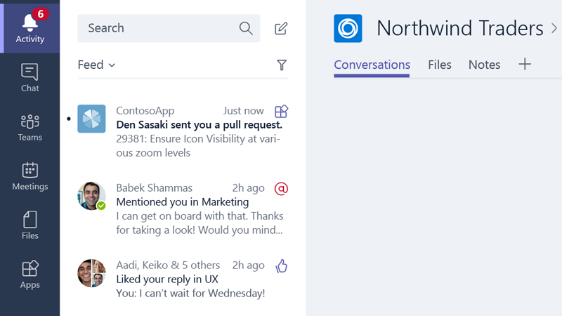
Activity Feed
Optionally send personal chat messages into the feed as preview cards summarizing your app's activity.
Construct the message such that choosing the card navigates the user straight to the message or object that triggered the notification, such as an entity in a tab.
Must include Text and Summary properties

Slide 8
Notification only bots
"bots": [ { "botId": "[MicrosoftAppId]", "scopes": [ "personal", "team" ], "isNotificationOnly": true, } ]
Bots can update the activity feed
If the sole purpose of the bot is to deliver notifications, consider a notification only bot.
Users cannot message your notification-only bot
Users cannot @mention the bot
bots node
isNotificationOnly property

Slide 9
Send and Receive file
Sending and receiving files through a bot can be accomplished via two different APIs
Microsoft Graph API
Obtain access to OneDrive folder (user or group drive)
Get reference to file
Post message to conversation with card attachment
Microsoft Teams API
Personal context (1:1) only
Enable files in manifest
Teams client provides a file picker experience
Teams client will store file in OneDriveCreate and then post activity with metadata, including content URL
Bot must download and handle file as appropriate
Notes:
Personal conversation requires User Id (from Teams) and Tenant Id

Slide 10
Enable send and receive
"bots": [ { "botId": "[MicrosoftAppId]", "scopes": [ "personal", "team" ], "supportsFiles": true, } ]
Teams client will handle file selection and storage
Handles scenario User -> Bot
bots node
supportsFiles property

Slide 11
Send and Receive files
Use the Microsoft Graph API
Use the Teams Bot API

Slide 12
Demo Sending and Receiving files

Slide 13

Summary
Conversations Notification-Only Bots Sending and Receiving Files (Preview)

Slide 14
Thank you

